Slide 1

ASSIGNMENT PROBLEM
Presentation by
R007 Bhagyashree Birje
R011 Tanishkaa Chaturvedi
R018 Neha Grandhi
R024 Kreesha Iyer

Slide 2
INTRODUCTION
An assignment problem is a particular case of transportation problem.
The objective is to assign a number of resources to an equal number of activities .
So as to minimize total cost or maximize total profit of allocation.
The assignment problem can be stated that in the form of mxn matrix cij called a Cost Matrix (or) Effectiveness Matrix where cij is the cost of assigning i th machine to j th job.

Slide 3
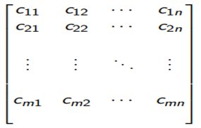
Mathematical Formula:
Minimize Z = Xn i=1Xn j=1cijxij
subject to the constraints
Xn i=1 xij = 1, j = 1, 2, ..., n
Xn j=1 xij = 1, i = 1, 2, ..., n
xij = 0 or 1.

Slide 4
Differentiation Between Transportation and Assignment Problem
S no. | Transportation Problem | Assignment Problem
1 | Supply at any source may be any positive quantity ai. | Supply at any source (machine)will be 1. i.e.,ai = 1.
2 | Demand at any destination may be any positive quantity bj. | Demand at any destination (job) will be 1. i.e.,bj = 1
3 | One or more source to any number of destinations. | One source (machine) to only one destination (job).

Slide 5
NEW METHOD
“Optimal Solution of an Assignment problem as a special case of Transportation Problem”", International Journal of Emerging Technologies and Innovative Research, ISSN:2349-5162, Vol.5, Issue 1, page no.198-203, January-2018.

Slide 6
Algorithm
Steps followed:
Step 1: Construction of cost matrix with dummy rows or columns if needed
Step 2: Subtract the smallest element found in the first row and first column from those respective row/column only.
Step 3: For each row and each column, identify the smallest element and subtract it in the row/column except the ‘L-shape’ of matrix
Step 4: Making assignments row-wise top to bottom first and then performing the same column-wise from left to right. We cross off all the other zeros in the corresponding row/column. In case there are multiple unmarked zeros, we choose a zero element arbitrarily.
Step 5: Repeat the above steps until optimality arises

Slide 7
Algorithm
Test for optimality
Step 1:
a) If all zero elements have been marked and there exists exactly one assignment for each row/column, then it is an optimal solution.
b) If a zero element was chosen arbitrarily, it means there exists alternative optimal solutions.
c) If there is no assignment in a particular row/column, then follow Step 2

Slide 8
Algorithm
Step 2:
Make a set of horizontal and vertical lines to cover all the zeros in the revised cost matrix and develop the revised cost matrix by:
Identify the minimum element ‘t’ such that it is not covered by any line
Subtracting ‘t’ from every element in matrix that is not covered by a line
Adding ‘t’ to every element at intersection of two lines
Other elements remain unchanged.
Repeat the above steps till optimality has been achieved.
Final solution: Add the original costs for elements in the occupied cells.

Slide 9
MAXIMIZATION PROBLEM

Slide 10
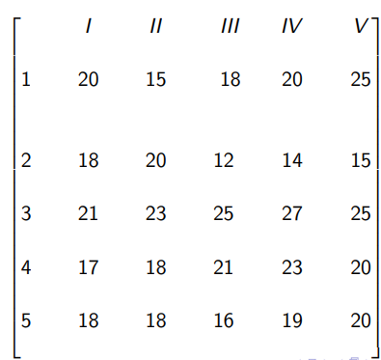
Problem
Solve the following assignment problem shown in Table using New Method. The matrix entries are processing time of each man in hours. Find the maximum time

Slide 11
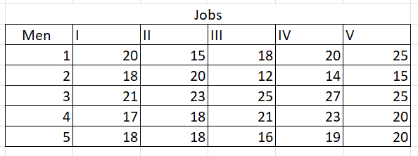
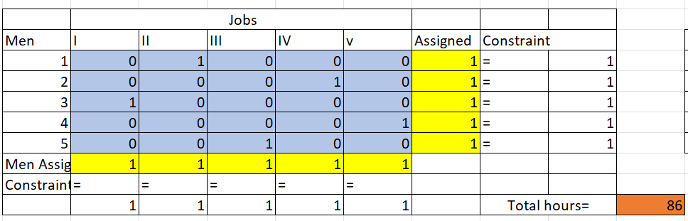
Excel Implementation

Slide 12
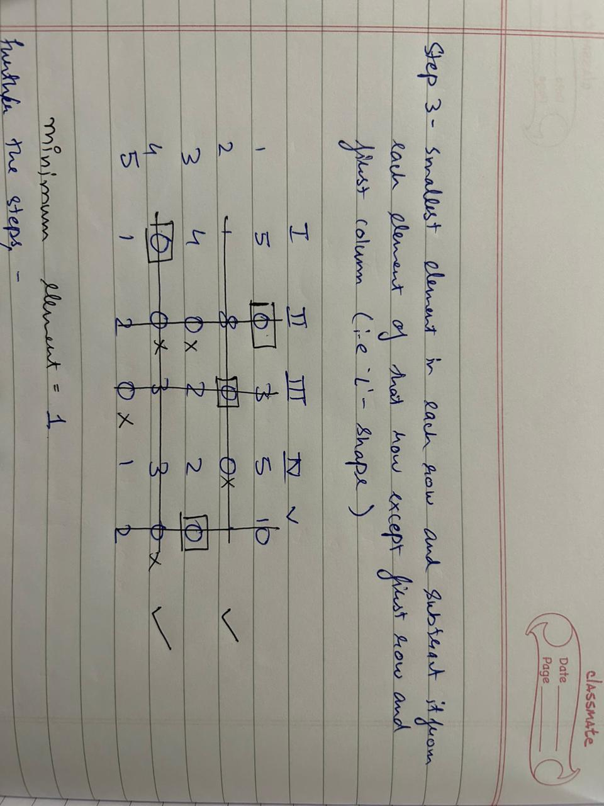
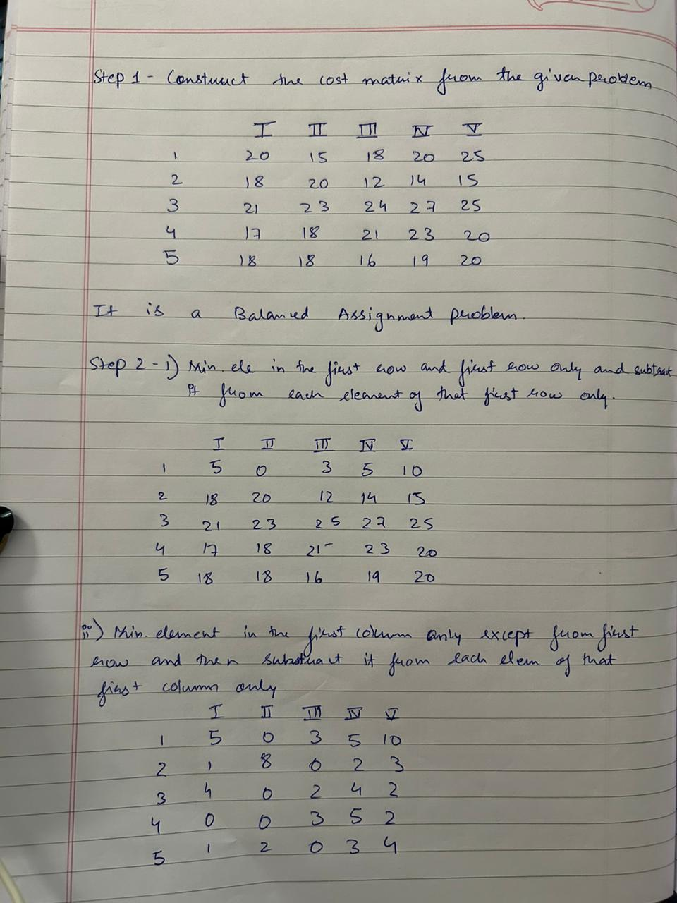
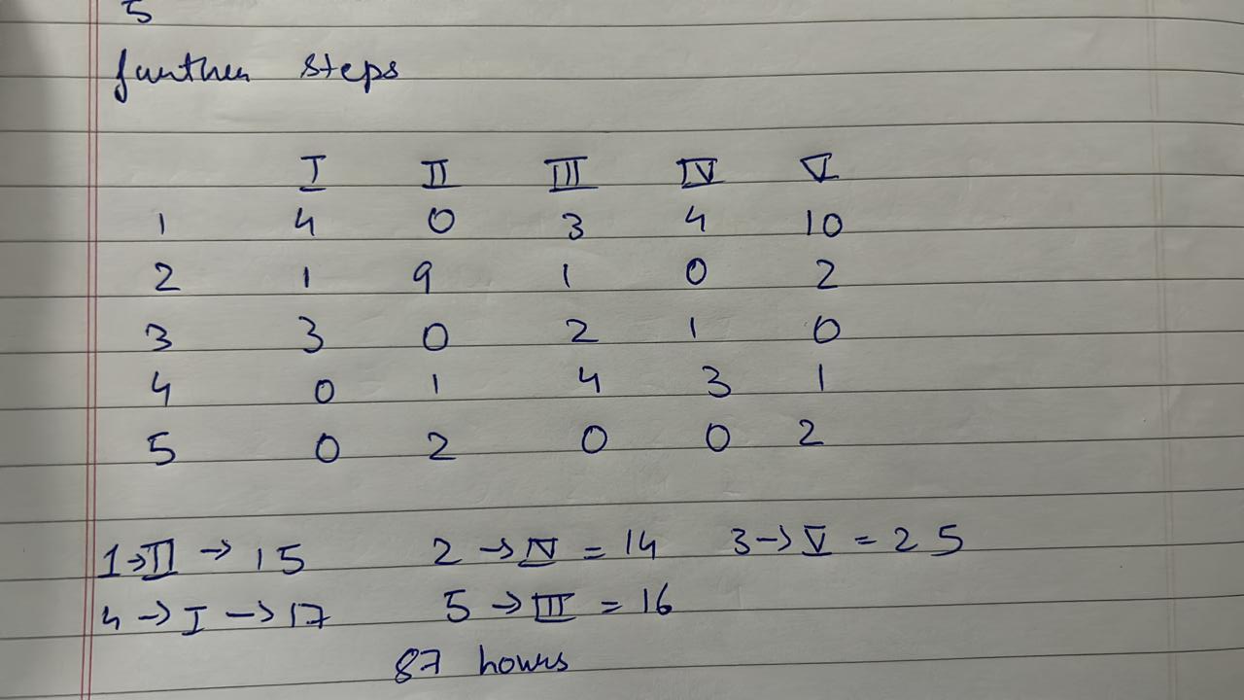
Working

Slide 13
RESTRICTED PROBLEM

Slide 14
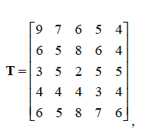
The problem
The durations (in days) for completing 5 processes by 5 crews in a construction project is presented in matrix T.
The following technological constraints exist for the completion of the construction project:
Crew A does not have the training to work on process Q.
Find the allocation for a minimum number of days to finish all the processes in the project.

Slide 15
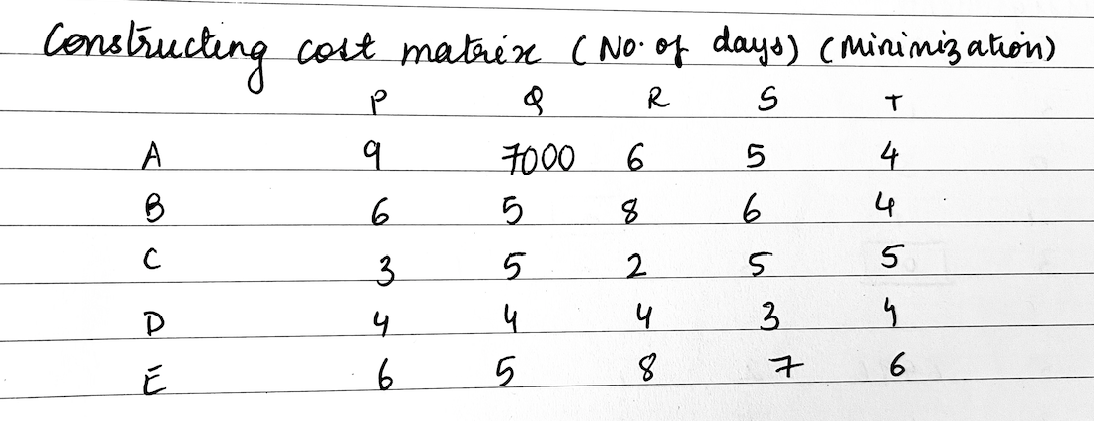
The Working

Slide 16
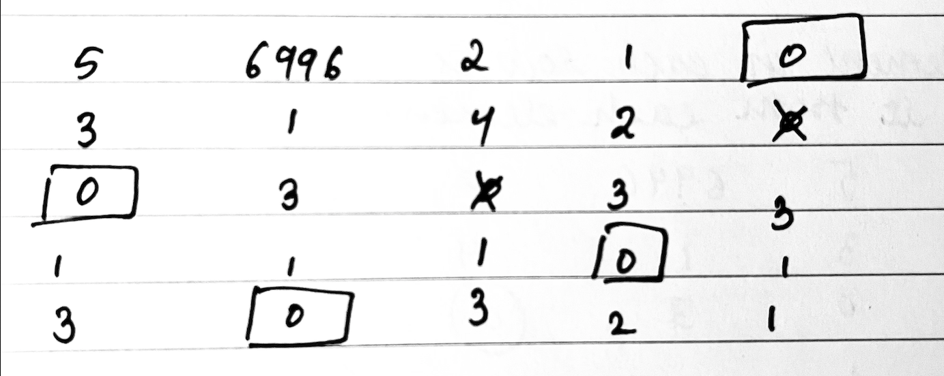
The Working

Slide 17
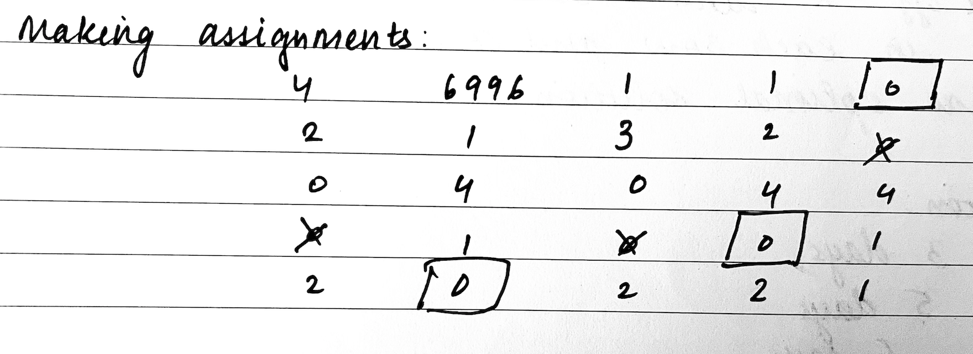
The Working

Slide 18
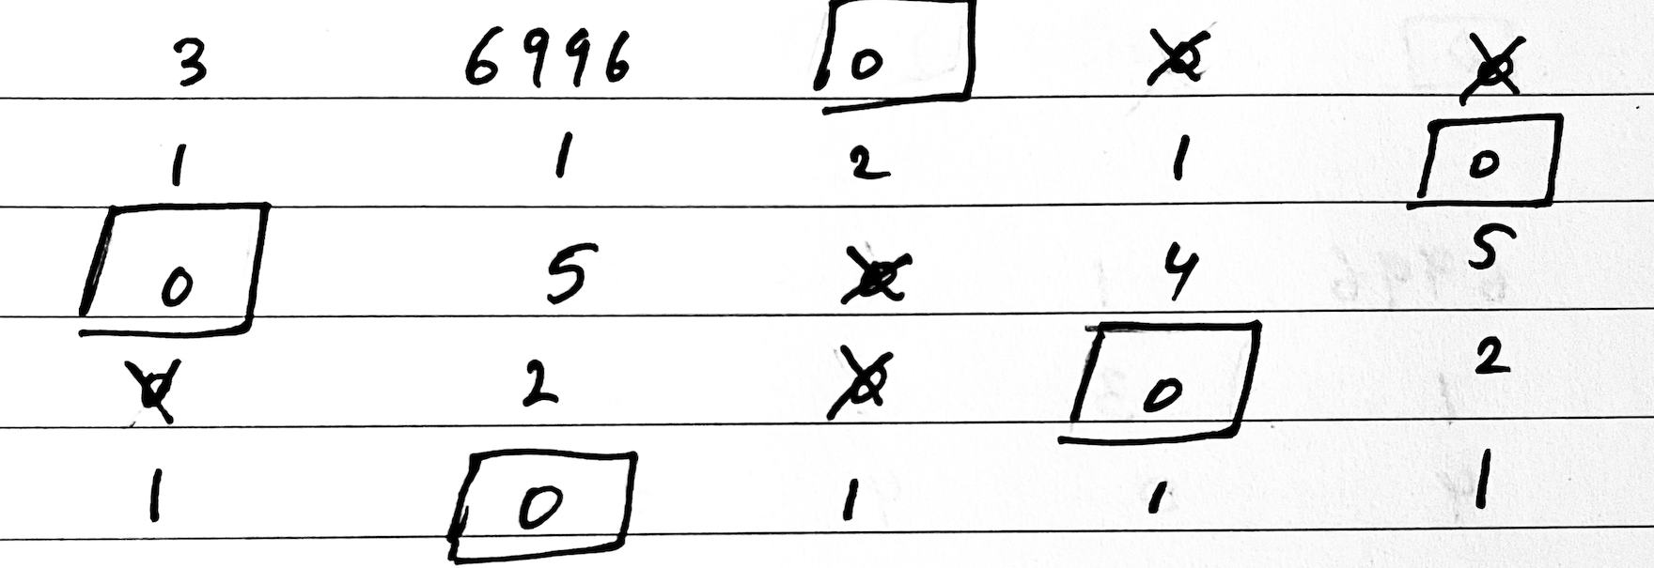
The Working

Slide 19
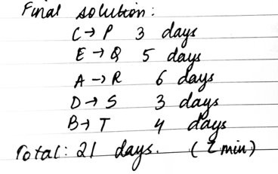
The Working

Slide 20
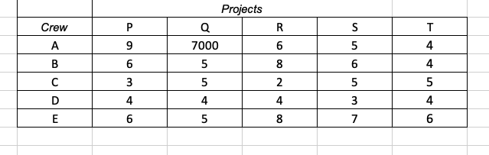
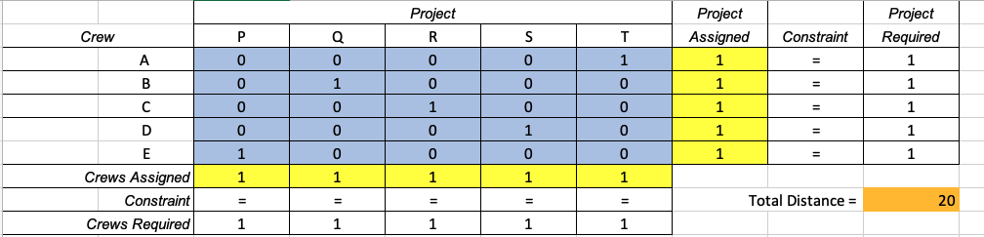
Excel Implementation

Slide 21
HUNGARIAN METHOD

Slide 22

ALGORITHM
Step 1.
1
Subtract the smallest entry in each row from all the other entries in the row. This will make the smallest entry in the row now equal to 0.
Step 2.
2
Subtract the smallest entry in each column from all the other entries in the column. This will make the smallest entry in the column now equal to 0.
Step 3.
3
Draw lines through the row and columns that have 0 entries such that the fewest lines possible are drawn.
Step 4.
4
If there are n lines drawn, an optimal assignment of zeros is possible and the algorithm is finished. If the number of lines is less than n, then the optimal number of zeroes is not yet reached. Go to the next Step 5.
Step 5.
5
Find the smallest entry (es) not covered by any line. Subtract this entry from each row that isn’t crossed out, and then add it to each column that is covered by two lines. Then, go back to Step 3.

Slide 23
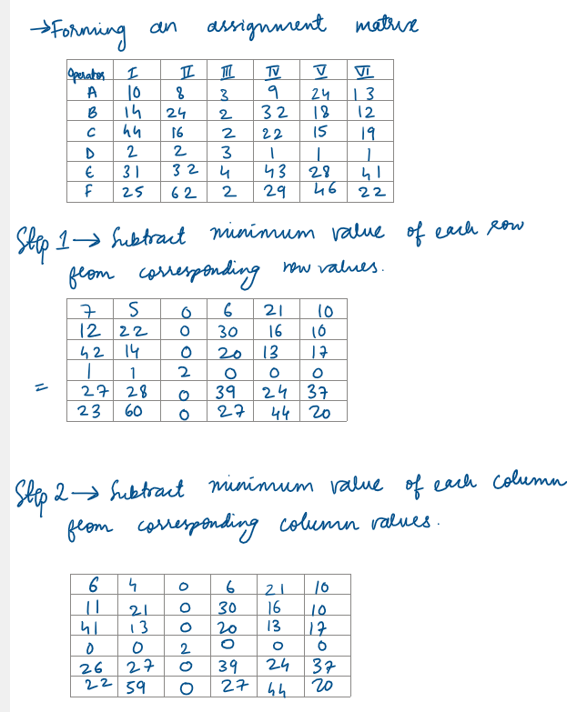
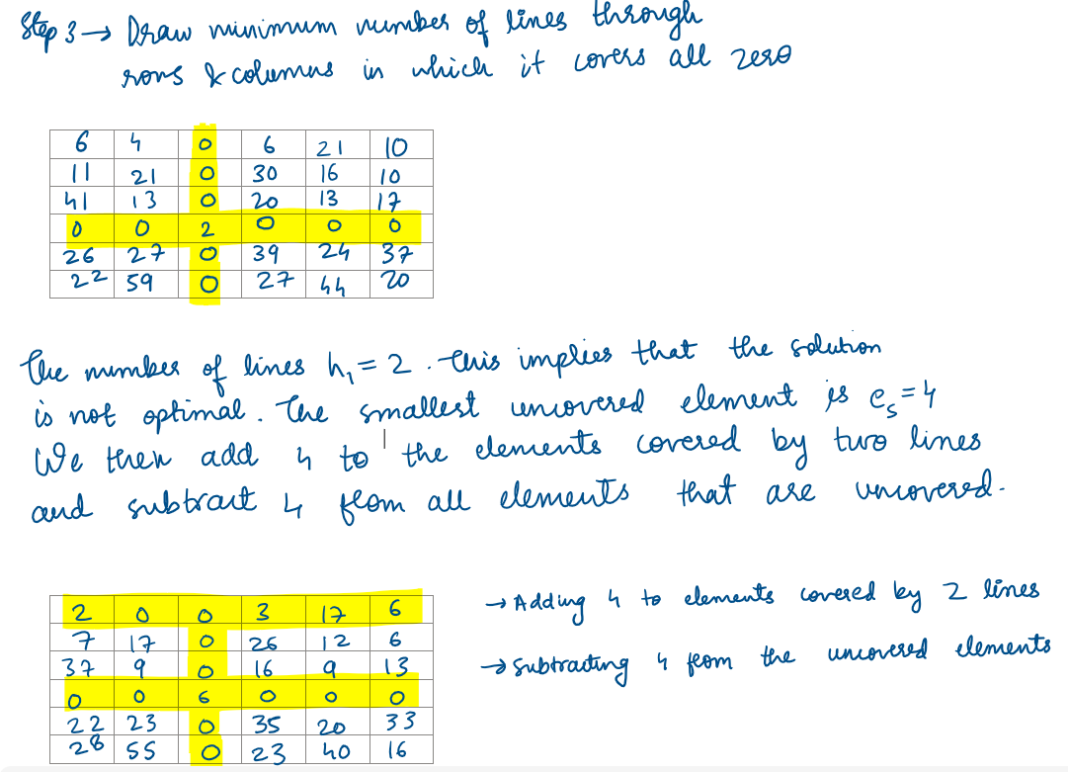

Slide 24
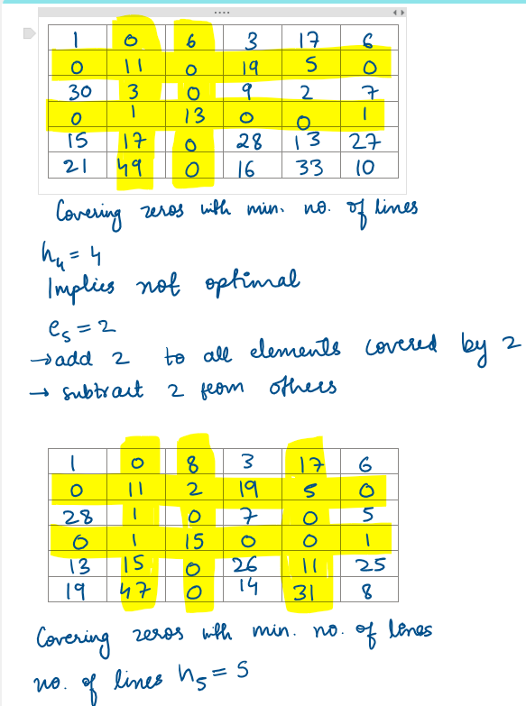
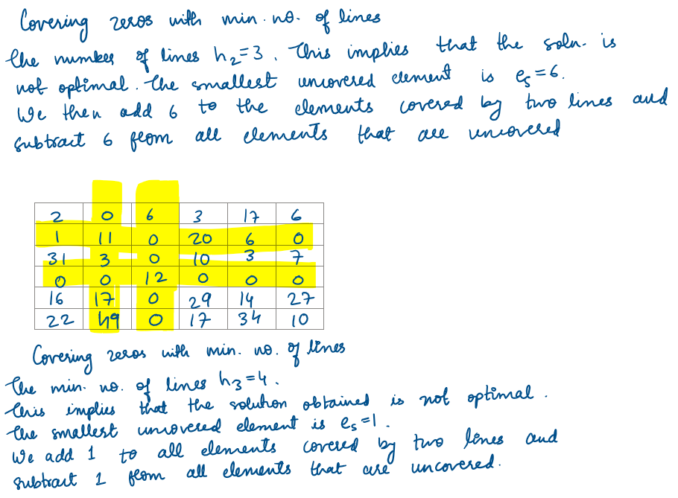

Slide 25
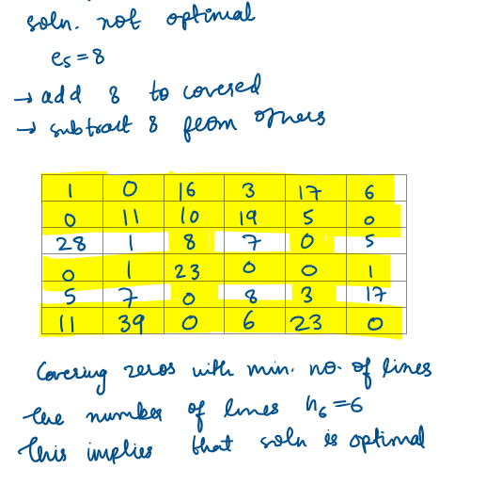

Slide 26
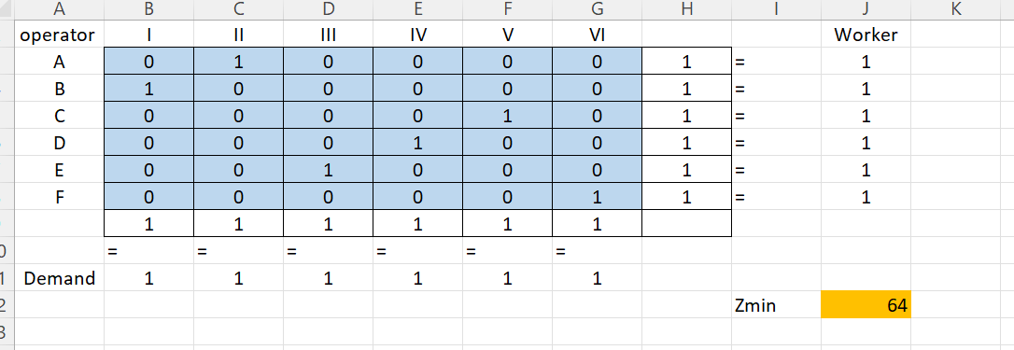
EXCEL SOLVING

Slide 27
UNBALANCED PROBLEM

Slide 28
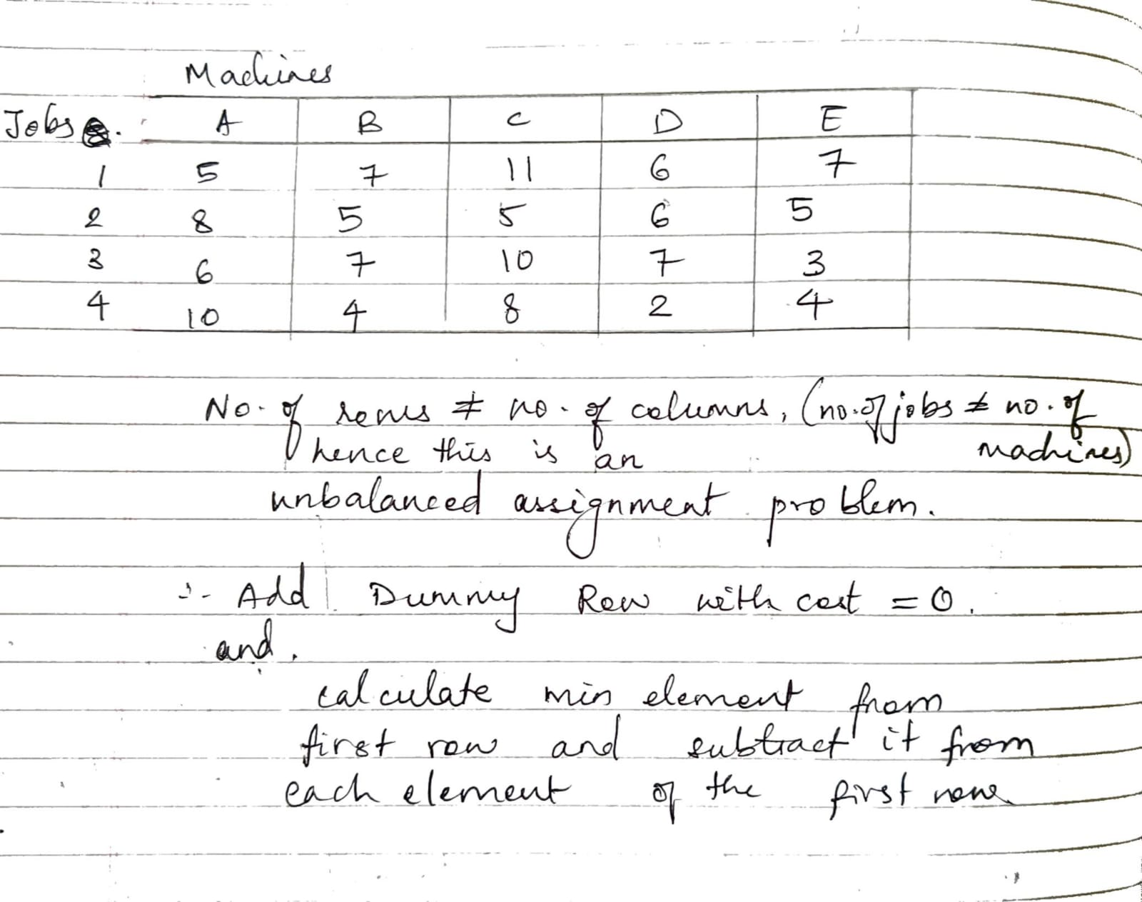
Unbalanced Problem- Manual

Slide 29
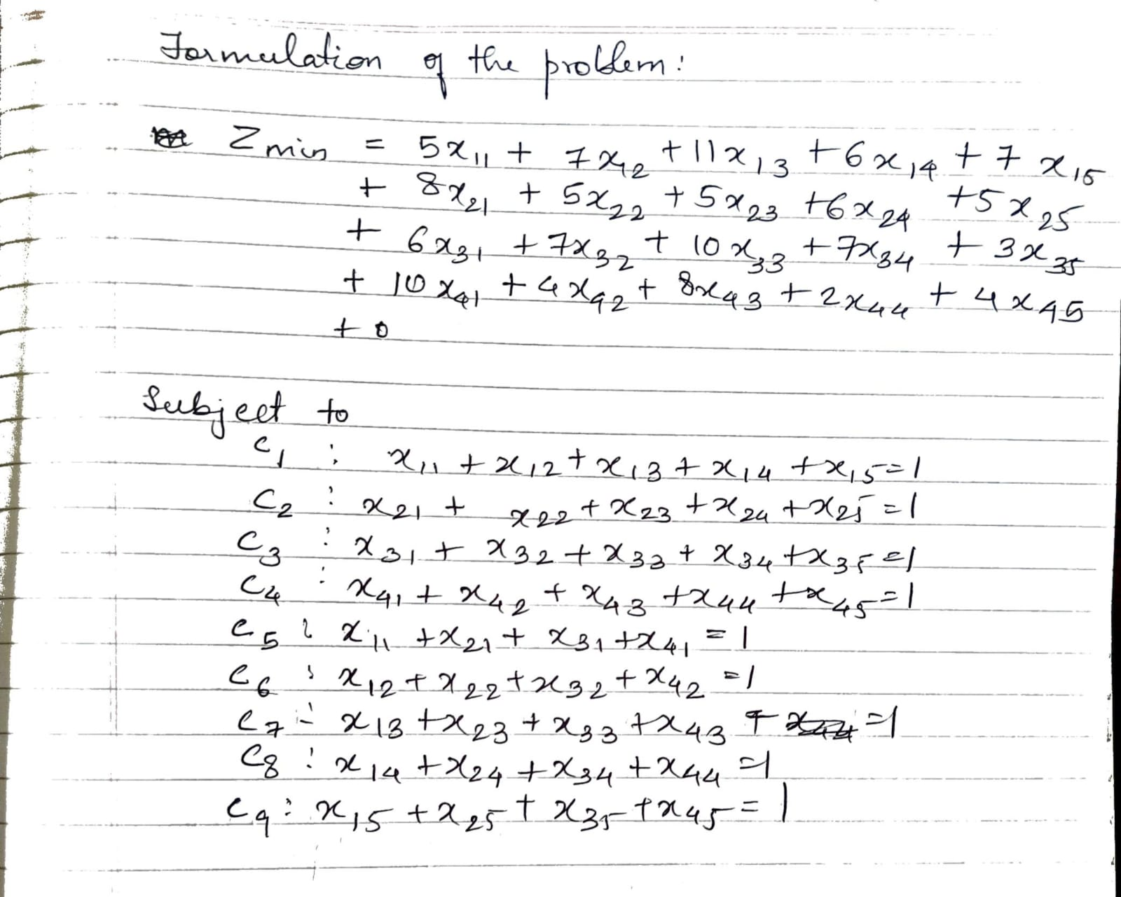

Slide 30
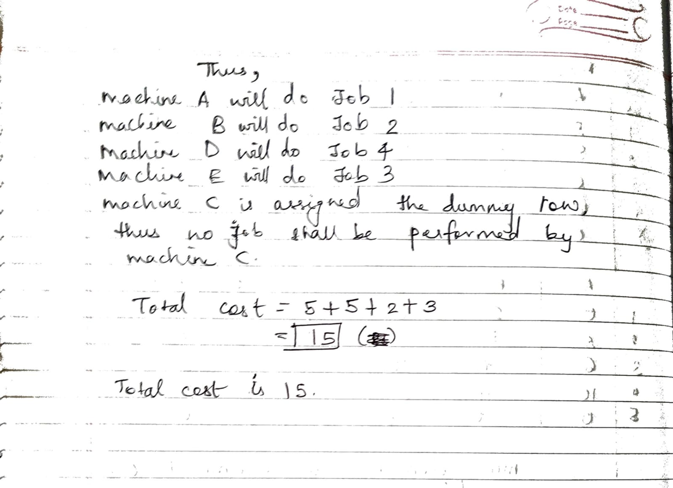

Slide 31
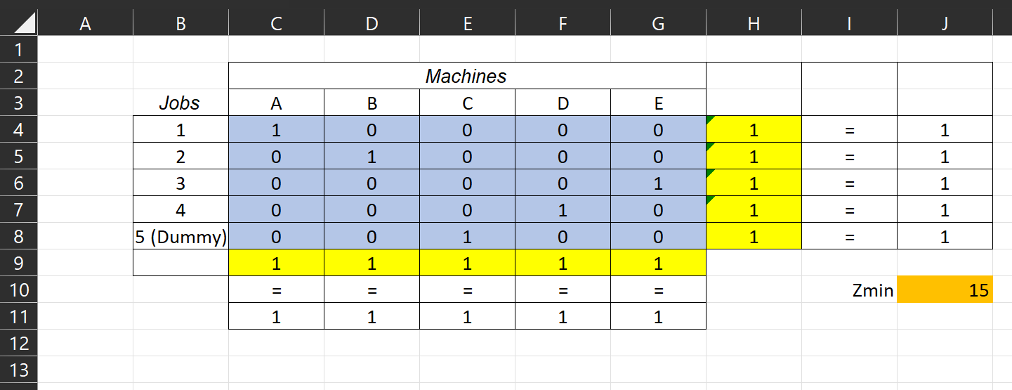
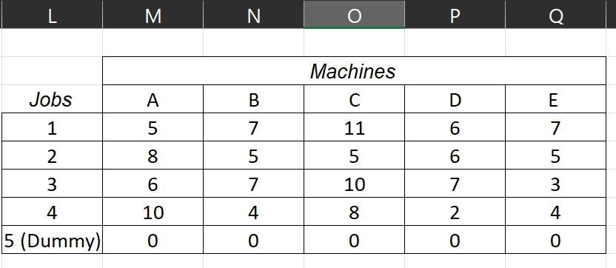
Unbalanced Problem – Excel

Slide 32
Disadvantages of Hungarian Method
If is it an unbalanced problem some tasks are left not assigned
It assigns tasks in 1-1 mapping only
It requires a lot of iterations

Slide 33
Advantages of New Method
the aggregate time taken by this strategy for finding optimal solution is less
Ensures that each row and column of whole cost matrix has at least one zero element
Less iterations than Hungarian Method

Slide 34

REAL LIFE APPLICATIONS OF ASSIGNMENT PROBLEM

Slide 35




Workforce Management
Manufacturing
Transportation
Sports Scheduling

Slide 36



Resource Allocation: Allocating resources to tasks/projects to minimize cost and ensure timely completion​
Medical Applications: Assigning patients to hospital beds/nurses/doctors to minimize waiting time and optimize resource usage​
Data Association: Matching observations with tracks in surveillance systems to minimize tracking error​
Education: Assigning students to classes/courses based on academic performance and interests to maximize academic performance​

Slide 37
CONCLUSION
Assignment problem is important in optimization techniques with real-life applications.
Different methods can be used to solve the problem, including manual solving techniques such as maximization, minimization, balanced, unbalanced Problem, and the Hungarian method.
Excel provides an efficient and accurate approach to solving the problem.
Understanding the assignment problem and its solving techniques is crucial for making optimal decisions in real-life situations.

Slide 38
REFERENCES
http://www.jetir.org/papers/JETIR1801037.pdf
https://www.researchgate.net/publication/344559969_Development_of_an_accelerating_hungarian_method_for_assignment_problems
https://ijisrt.com/wp-content/uploads/2017/10/New-Approach-to-Solve-Assignment-Problem.pdf

Slide 39
THANK YOU

